Slide 1


How transparency can help your agribusiness reach new markets
Dr. Gerd Meier zu Köcker, Jon Goriup
Anteja Africa

Slide 2
Anteja Africa
Value chain experts with 15+ years working on sustainable development of value chains for prestigious institutions such as the World Bank, IFC and European Commission.
Have developed sustainable agribusiness value chains across Europe and Africa.
Our Mission
To empower African agribusinesses and improve their market position, making agri value chains shorter and transparent, and to improve livelihoods of smallholder farmers.
Notes:
Baobab trees

Slide 3
TOPICS
I
Transparency – What it is & why it is
important
Achieving transparency
Opportunities for transparent agribusinesses
phy2app – Digital transparency solution
II
III
IV
Confidential & Proprietary. Copyright © Anteja Africa Ltd, All rights reserved.

Slide 4
Transparency
What is it? Why is it important?
Confidential & Proprietary. Copyright © Anteja Africa Ltd, All rights reserved.

Slide 5



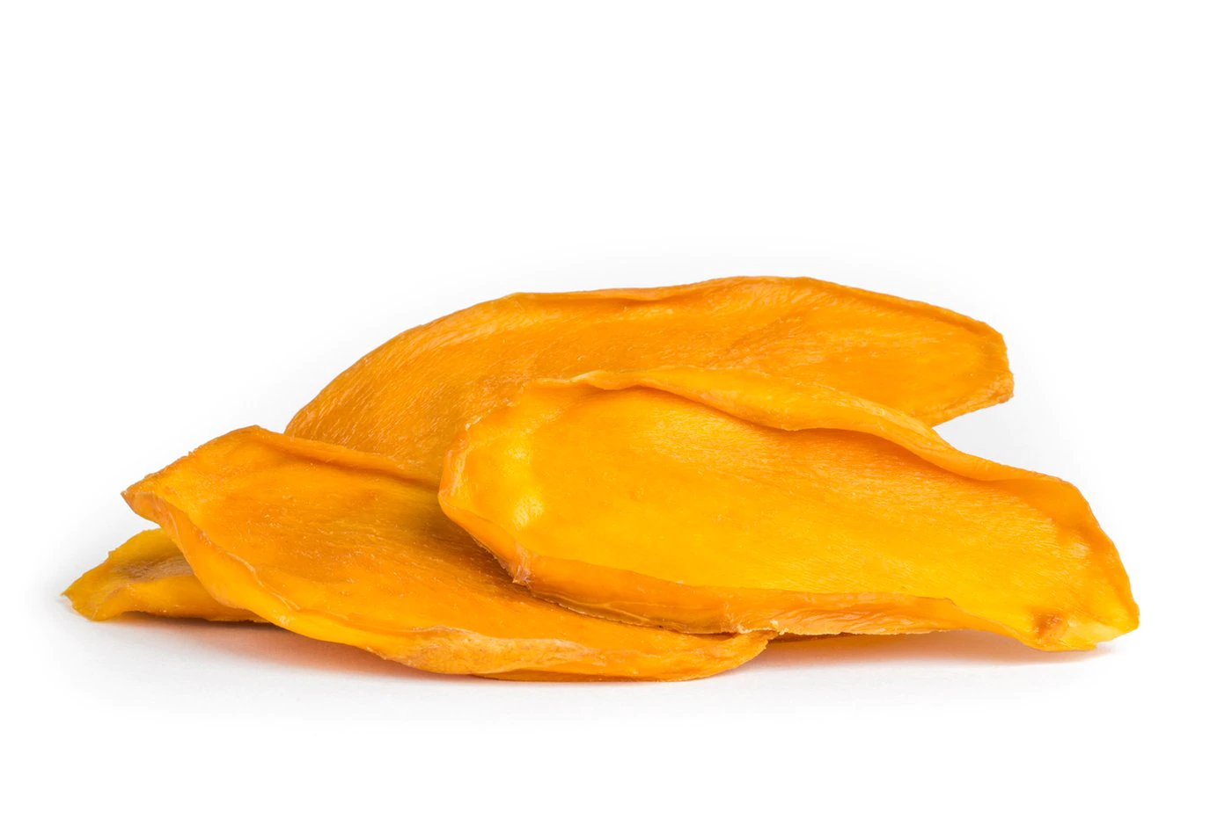
Miyonga
Producer & exporter of dried fruits
(Kenya)
Transparency success story & Impact
Using transparency as an added value, Miyonga was able to get buyers from Europe and Middle East.
Miyonga increased sales by over 10% p.a. since focusing on transparency and traceability
Confidential & Proprietary. Copyright © by Anteja Africa Ltd, All rights reserved.

Slide 6


Pelere Group
Producer of shea butter products (Uganda)
Transparency success story & Impact
Active communication of transparency helped Pelere to find new buyers in Ethiopia and Germany
Pelere nowdays has access to retail stores
Confidential & Proprietary. Copyright © by Anteja Africa Ltd, All rights reserved.

Slide 7

2021 Trend #1 Transparency Triumphs
Radically transparent, sustainable and healthy products
It is no longer only about quality but also about ethics, environment & health!
Confidential & Proprietary. Copyright © Anteja Africa Ltd, All rights reserved.

Slide 8
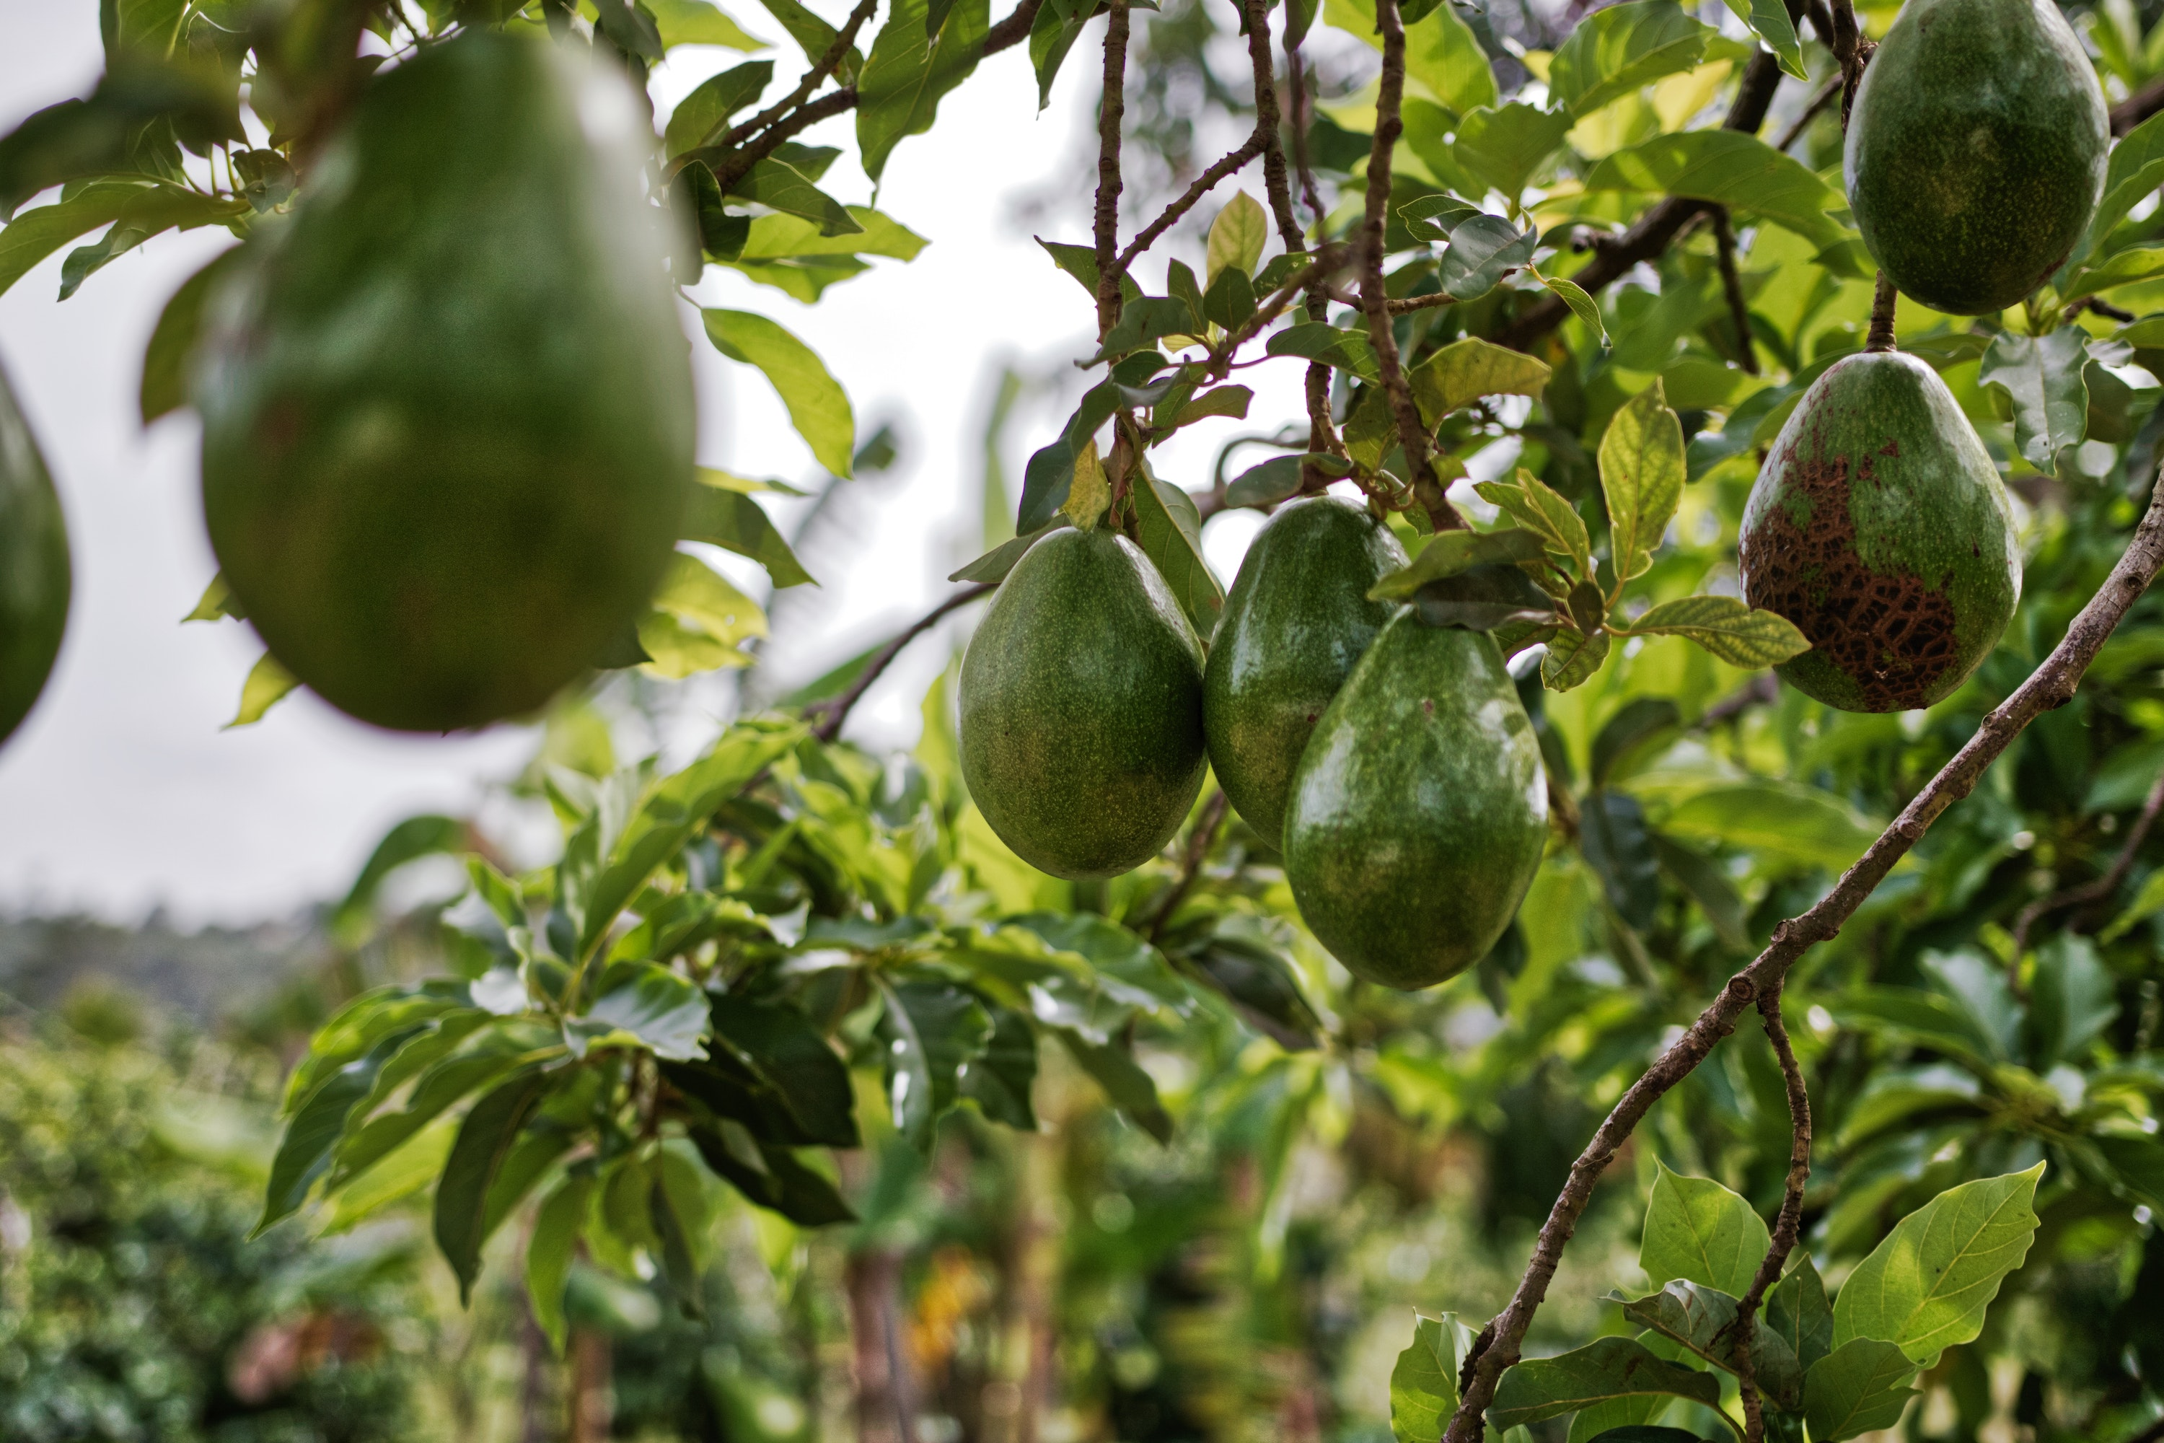
Transparency…
a journey of New Business Values
Trust
Sustainability
Long-term growth
Leadership
Transparency requires companies…
to know what is happening in the supply chain and to motivate sustainable practices in the chain
to communicate this information and knowledge both internally within your company and externally
Notes:
What is transparency

Slide 9






Where the pressure is coming from
Pressure on agribusinesses to become transparent!
92% of companies are trying to improve visibility!
Sustainability pressure from consumers, governments & NGOs
Confidential & Proprietary. Copyright © Anteja Africa Ltd, All rights reserved.

Slide 10
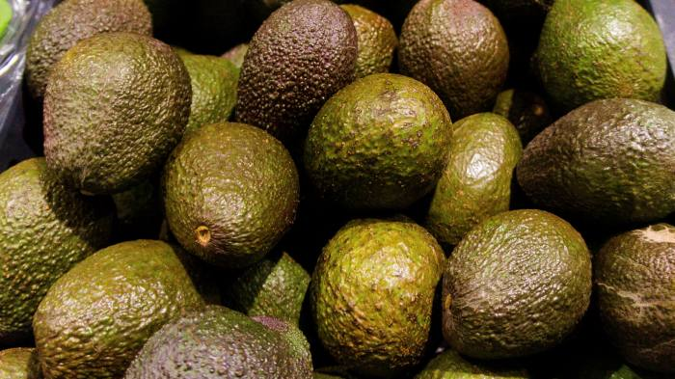
Reputational risks & market loss
Tesco, Sainsbury's and Lidl drops avocado supplier after allegations of rights abuse
Suppliers must meet strict standards, from the farm to its destination at the points of sale:
Food safety, quality
Human rights
Environmental
sustainability
Confidential & Proprietary. Copyright © Anteja Africa Ltd, All rights reserved.

Slide 11
Is there a benefit to transparency?
Consumers may be willing to pay up to 10% more for products from companies that provide greater supply chain transparency.
Reduce reputation risk
Meet demands of the markets
Confidential & Proprietary. Copyright © Anteja Africa Ltd, All rights reserved.

Slide 12
Transparency is not yet another compliance requirement…
  …it is the new Benchmark
  in business conduct
Confidential & Proprietary. Copyright © Anteja Africa Ltd, All rights reserved.

Slide 13
Achieving Transparency
Confidential & Proprietary. Copyright © Anteja Africa Ltd, All rights reserved.

Slide 14






Achieving transparency
Conduct a transparency stress test & set goals
Visualize the supply chain
Collect & document actionable information
Address the identified issues
Share the information
Confidential & Proprietary. Copyright © Anteja Africa Ltd, All rights reserved.

Slide 15





  Collect & document information
Get to know your supply chain & processes
Document your knowladge and understating of your supply chains & processes
Collect and organize the documented information
TRANSPARENCY INFO
Confidential & Proprietary. Copyright © Anteja Africa Ltd, All rights reserved.

