Slide 1

UPSCALING OF MANUFACTURING SME’S IN NATURAL FOOD CLUSTERS
Pitch decks

Slide 2

PitchꢀDeckꢀ
Preparation
Today’s
Program
Review,ꢀ
Q&A

Slide 3

Slide
Content
Problem
Explainsꢀtoꢀinvestorsꢀtheꢀneedꢀyouꢀareꢀaddressingꢀ
withꢀanꢀaimꢀofꢀgettingꢀbuyꢀin
ContentsꢀofꢀaꢀPitchꢀ
deck
Solution
Howꢀyourꢀbusinessꢀoffersꢀtheꢀsolutionꢀtoꢀthisꢀ
problem
MarketꢀSize
BusinessꢀModel
Howꢀbigꢀisꢀtheꢀoverallꢀmarket?ꢀTheꢀaddressableꢀ
marketꢀ(TAM)?
Howꢀwillꢀ/ꢀdoesꢀyourꢀbusinessꢀmakeꢀmoney?
• Shouldꢀbeꢀshortꢀ(10-20ꢀslides)ꢀ
butꢀcaptivatingꢀandꢀsuccinct
Competitionꢀ&ꢀ
Competitiveꢀadvantage
Provideꢀaꢀcompleteꢀviewꢀofꢀtheꢀcompetitiveꢀ
landscape
Managementꢀteam/ꢀ
Boardꢀ/ꢀAdvisors
Whoꢀwillꢀexecuteꢀonꢀtheꢀopportunityꢀ/ꢀwhatꢀareꢀtheirꢀ
capabilities?
Tractionꢀ/ꢀ
Accomplishmentsꢀtoꢀ
date
Currentꢀtractionꢀ(e.g.,ꢀnoꢀofꢀcustomersꢀetc.),ꢀproductꢀ
developmentꢀetc
Financialꢀprojectionsꢀ&ꢀ
Keyꢀmetrics
3–5-yearꢀfinancialꢀprojections
Fundingꢀrequirementꢀ/ꢀ
ofꢀfunds
Howꢀmuchꢀmoneyꢀisꢀneeded,ꢀinꢀwhatꢀformꢀ(e.g.,ꢀ
debt/equity/convertible)ꢀandꢀforꢀwhatꢀpurpose

Slide 4

ProblemꢀGapꢀidentification
Solutionꢀthatꢀyourꢀbusinessꢀisꢀofferingꢀtoꢀsolveꢀtheꢀproblemꢀ
alreadyꢀidentified.
AreꢀyouꢀableꢀtoꢀgiveꢀtheꢀSolutionꢀinꢀnumericalꢀterms
Reviewꢀtheꢀ
Contentsꢀofꢀ
theꢀPitchꢀ
Deck
MarketꢀSize-ꢀHowꢀbigꢀisꢀtheꢀmarketꢀsizeꢀinꢀnumericalꢀterms.ꢀHowꢀmuchꢀ
revenueꢀaꢀbusinessꢀcanꢀpossiblyꢀgenerateꢀbyꢀsellingꢀtheirꢀproductꢀorꢀserviceꢀ
inꢀaꢀspecificꢀmarket
Howꢀdoesꢀyourꢀbusinessꢀmakeꢀmoney…DirectꢀSales,ꢀRoyalties,ꢀ
SubscriptionꢀModels
ManagementꢀTeam-ꢀWhichꢀPeopleꢀinꢀtheꢀOrganizationꢀareꢀtasked/ꢀ
responsibleꢀtoꢀexecuteꢀtheꢀbusiness,ꢀtheirꢀcapabilities(ꢀExperience,ꢀ
qualification,ꢀtheirꢀrole)
Anyꢀaccomplishmentsꢀtoꢀdate
FinancialꢀModels
ExactꢀFinancingꢀNeeds-ꢀAfterꢀidentification,ꢀweꢀwillꢀproceedꢀtoꢀ
structure

Slide 5

[Your Company Name]
[Yourꢀtagline]
Nameꢀ|ꢀRole
email@company.com

Slide 6

The
Problem
1.Defineꢀtheꢀproblemꢀyouꢀareꢀ
lookingꢀꢀtoꢀsolve
2.ꢀStateꢀproblemꢀClearly

Slide 7

Solution
SpecializedꢀServices
ProvidingꢀLinkages.
Productꢀmeetingꢀaꢀcertainꢀ
needꢀandꢀmarketꢀ

Slide 8

Addꢀyourꢀshortꢀvideoꢀtoꢀthisꢀslide

Slide 9
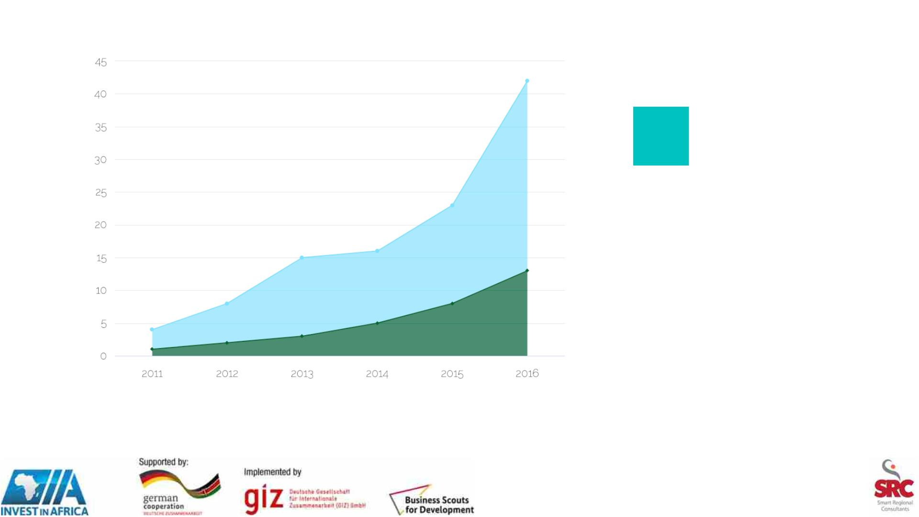
Marketꢀ
Size
Averageꢀsizeꢀofꢀ
Market.
IfꢀinꢀExportꢀ,ꢀdefineꢀ
theꢀmarketꢀSize
Whatꢀisꢀyourꢀshareꢀ
ofꢀthisꢀmarket
Source: Forrester / Gartner / your Uncle

Slide 10

BusinessꢀModel
PaymentꢀMode
Royalties
Commissions
DirectꢀSales

Slide 11

PropietaryꢀTechnologyꢀ/ꢀExpertise
• PatentedꢀDesigns
• PatentedꢀProductionꢀProcesses
• OrganicꢀorꢀNaturalꢀProductsꢀ/ꢀRawꢀMaterials

Slide 12

Competition
IndustryꢀOverview
CompetitiveꢀPositioning
CompetitiveꢀGrowthꢀStrategy

Slide 13

Whyꢀus?
OnꢀtimeꢀDelivery.
CustomerꢀSatisfaction.
ProductꢀQuality.

Slide 14

Go-toꢀMarketꢀPlan
CustomerꢀAcqusitionꢀChannels
ꢀ
.ꢀ
ꢀ

Slide 15

Management Team
CEO
CFO
QA
Shortꢀbio
Shortꢀbio
Shortꢀbio

Slide 16

FinancialꢀProjections/ꢀ
Models
• CurrentꢀIncomeꢀStatement-ꢀSummaryꢀofꢀSalesꢀ,ꢀ
CostꢀofꢀSalesꢀandꢀExpensesꢀofꢀtheꢀOrganizationꢀ
forꢀtheꢀpastꢀ3ꢀyears
• BalanceꢀSheetꢀ–ꢀFinancialꢀPositionꢀofꢀtheꢀ
OrganizationꢀforꢀtheꢀPastꢀ3ꢀYears
• AuditedꢀFinancialꢀStatementsꢀforꢀtheꢀpastꢀ3ꢀ
Yearsꢀ
• ProjectedꢀIncomeꢀStatement-ꢀShowingꢀgrowthꢀ
afterꢀfinancingꢀgapꢀhasꢀbeenꢀmet
• ProjectedꢀBalanceꢀSheetꢀ–ꢀShowingꢀPositiveꢀ
ChangeꢀofꢀtheꢀFinancialꢀpositionꢀonceꢀtheꢀ
financingꢀgapꢀhasꢀbeenꢀmet

Slide 17

FinancialꢀProjections
ꢀ

Slide 18

FundraisingꢀandꢀMilestones
Howꢀmuchꢀmoneyꢀareꢀyouꢀlookingꢀfor?
Ask
AtꢀaꢀvaluationꢀofꢀXXXX
• Howꢀdoꢀyouꢀwantꢀtheꢀmoneyꢀfinanced

